Slide 1
Spike Sorting
CMSC 635: KNOWLEDGE DISCOVERY & DATA MINING
Jie Wu, Yurong Luo, Ning Ren

Slide 2
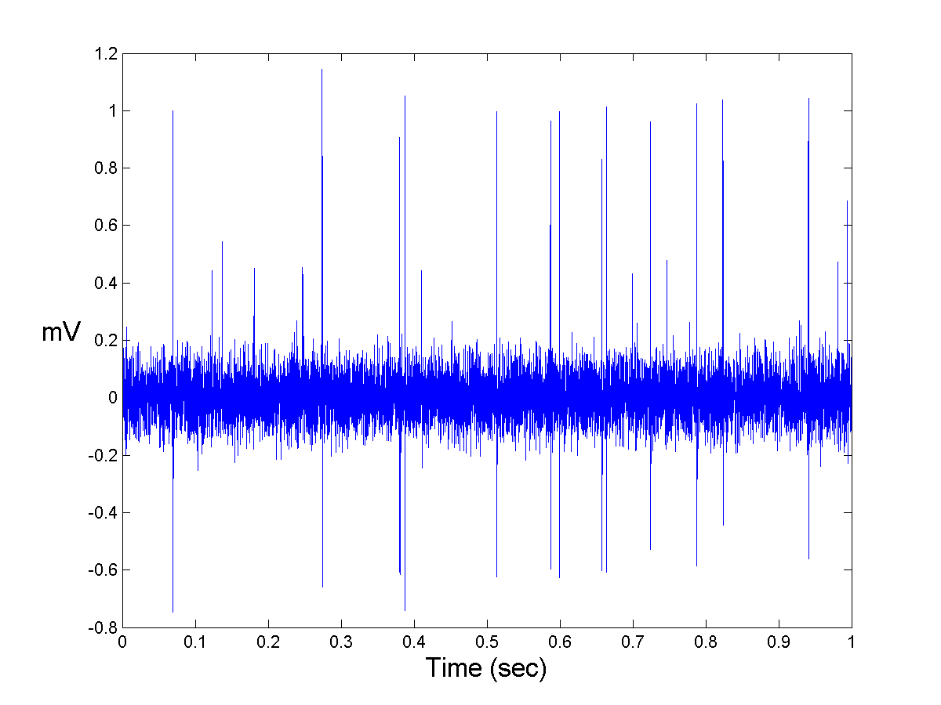



Understanding the problem domain
---Neural spike activity is a prerequisite for studying brain function
---Recording a neural spike activity may be disturbed by other neurons in local area
---Other factors: spike shapes are stationary or not/Electrode drift/two neuron produce the similar shape, noise influence, …
… …

Slide 3
Understanding the Dataset
2 dataset files for classification
1st dataset has 3383 instances, 65 attributes and three classes
2nd dataset has 3526 instances, 65 attributes and three classes
2 dataset file for clustering
1st dataset has 3440 instances and 64 attributes
2nd dataset has 3534 instances and 64 attributes
Data Format
.mat extension -----Matlab, .arff extension ------Weka

Slide 4
Preparation of the data
Observing characteristics of the data: High dimensionality; huge volumes;
problems related to data quality, like imprecision, incompleteness, noise, missing values, and redundancy
Pre-operation

Slide 5
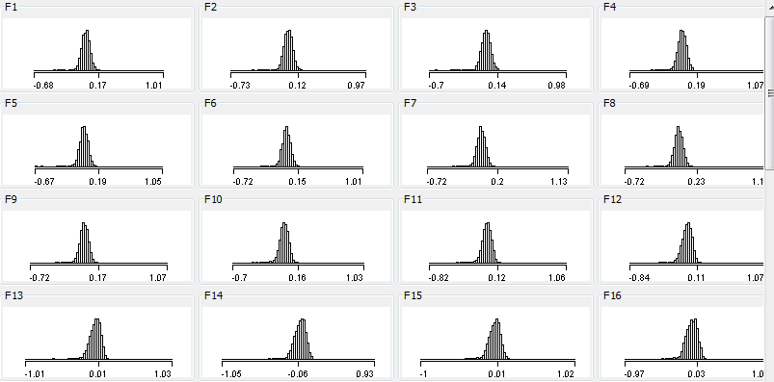
Values of feature
All of them are
  Real number
  Almost unique
  Well distributed

Slide 6
Feature Understanding
There are totally 64 features, but only 3 classes.
So we guess that..
Existing meaningless features, which has no much information contributed to class.
Existing redundancy redundancy features correlating to others, which are able to be represented by others.

Slide 7
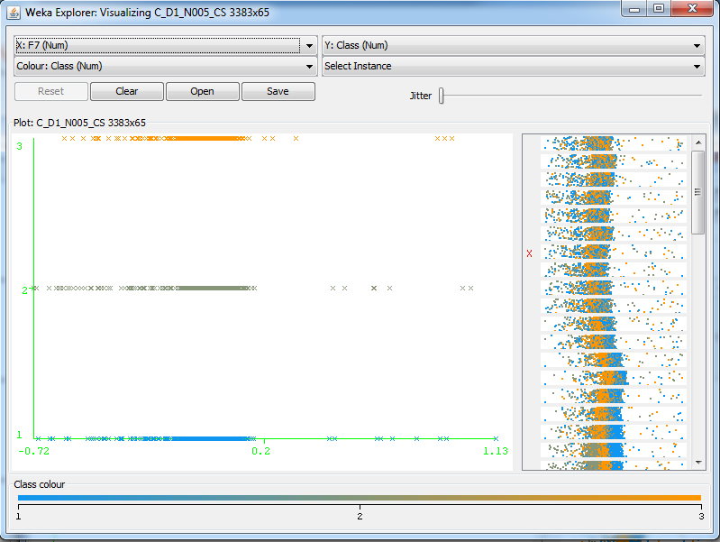
Feature Understanding

Slide 8
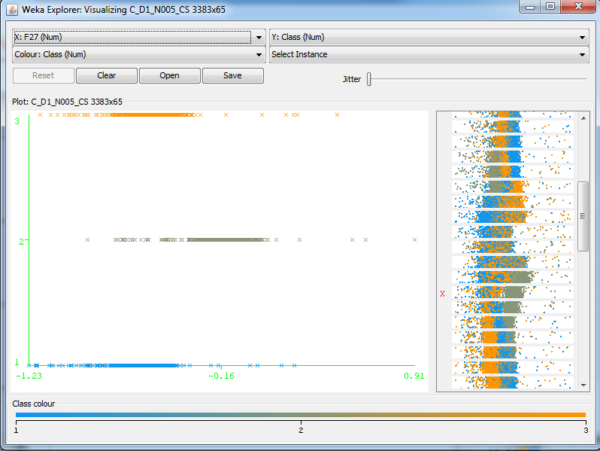
Feature Understanding

Slide 9
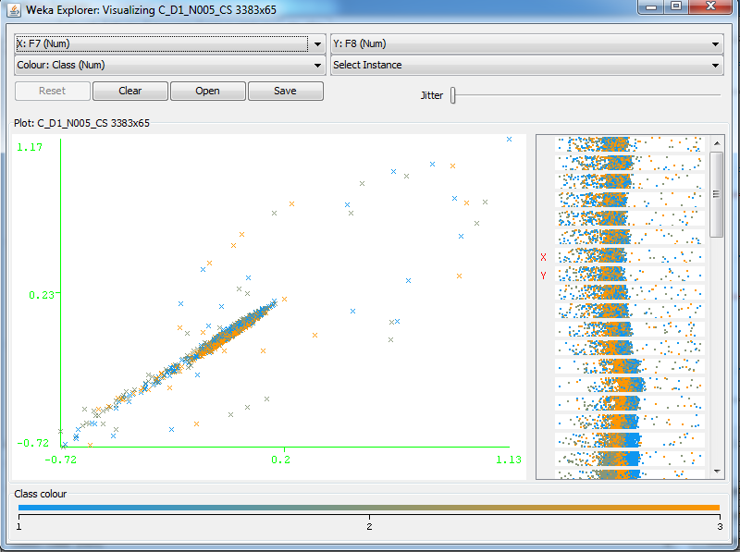
Feature Understanding

Slide 10
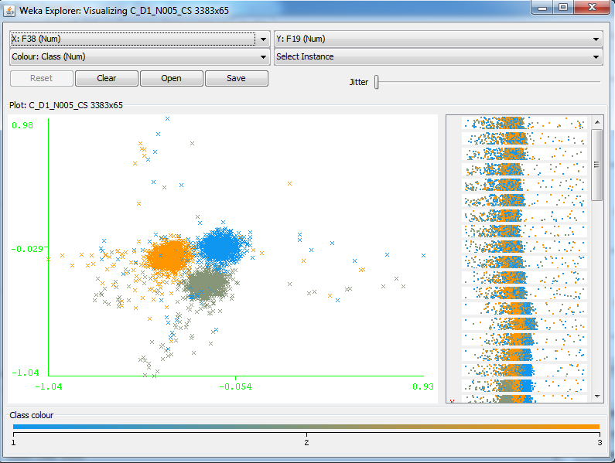
Feature Understanding

Slide 11
Data Mining - Preprocessing
Normalization
By analyzing all of the training data , determining the range of every attribute and transform the entire dataset appropriately.
Normalizing every point involves scaling every attribute between 1 and n.
Discretization
Reducing large continuous values into discrete values; Grouping into a given or ungiven number of categories , The obtained intervals can be interpreted as potential knowledge;
Remove the outliers……

Slide 12
Data Mining -Feature selection/Feature extraction
Reduce the dimensionality of the original data.
Feature extraction methods do it by generating new transformed features
Feature selecting methods choose a subset of original features.
Weka: CFsSubsetEval, ClassifierSubsetEval, PrincipalComponents, Wavelet, FFT…

Slide 13
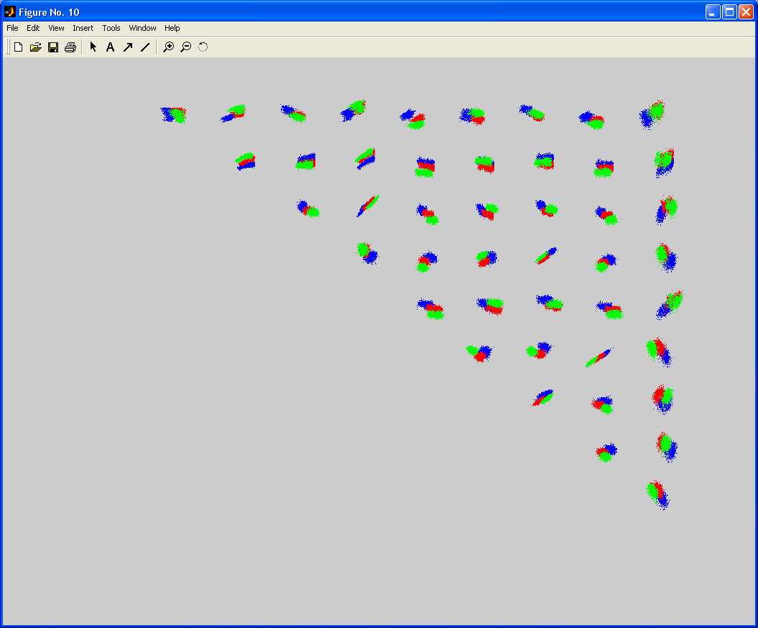
Data Mining ---- Clustering
The partitioning of a data set into subsets(clusters), so that the data in each subset (ideally) share some common trait.
Clusters separate clearly
in some projections
Weka: FilteredCluster, HierarchicalClusterer, SimpleKMeans, Xmeans, …

Slide 14
Data Mining ---- Classification
Weka: Bayes(NaiveBayes),Functions(SVM),Trees(J48,SimpleCart), …
Cross Validation
Statistical Results
Accuracy, Sensitivity, Specificity…

Slide 15
Evaluation and Conclusion
Explain and evaluate clustering results.
Explain and evaluate classification results.
Assess data mining model used for clustering and classification.
Choose the most robust algorithm.

Slide 16
Thanks!

